Slide 1


1/25
Department of Computer Science and Engineering
DETECTION OF KNEE OSTEOARTHRITIS AND ITS PREDICTION USING DEEP LEARNING
TEAM MEMBERS:
MUTHU ANNAMALAI.V 211416104171
KOULURU NANDA KISHORE REDDY 211419104142
MUKESH KUMAR.S 211419104142
GUIDE: DR.G SENTHIL KUMAR
PROJECT CO-ORDINATOR: DR.G SENTHIL KUMAR

Slide 2
Introduction
2/25
Osteoarthritis affects 30% of the global population over the age of 60 and is one of the leading causes of disability among older adults. Globally, OA affects more than 250 million people, causing 1–2% of the gross domestic product to be spent on it. Increasing aging in the global population will result in an increase in knee osteoarthritis (KOA) patients. The symptoms of KOA include pain, stiffness, loss of joint range of motion, and gait dysfunctions that worsen with the progression of the disease. It can be detrimental to an individual's quality of life and functional independence to suffer from these symptoms. Using standardized grading systems like Kellgren-Lawrence(KL) grading schemes, experienced radiologists grade the impairment severity. If knee OA is detected and classified early in a patient, corrective measures can be taken and humankind will benefit significantly. Although as of now there is no known cure for arthritis, the benefits of early detection can’t be understated. Our Knee Osteoarthritis Detection project helps patients detect Osteoarthritis in their knees. Along with helping with early detection, this web application also detects the severity of the disorder.

Slide 3
Literature Survey
3/25
S.No | Journal Type with year | Authors | Title | Outcomes
1. | Knee Surg. Sports Traumatol. Arthrosc. 23 (12), 3532–3539. 2015 | Culvenor, A.G., Engen, C.N., iestad, B.E., Engebretsen, L., Risberg, M.A. | Defining the presence of radiographic knee osteoarthritis: a comparison between the Kellgren and Lawrence system and OARSI atlas criteria | Quantitatively measured transitions in KL grade and JSN
2. | 23rd International Conference on Pattern Recognition (ICPR), Cancun, Mexico, 2016 | Antony, J., McGuinness, K., O’Connor, N.E., Moran, K. | Quantifying radiographic knee osteoarthritis severity using deep convolutional neural networks. | knee osteoarthritis severity using convolutional neural networks
3. | IEEE 15th International Symposium on Biomedical Imaging (ISBI 2018) | A. Raj, S. Vishwanathan, B. Ajani, K. Krishnan, and H. Agarwal | Automatic knee cartilage segmentation using fully volumetric convolutional neural networks for evaluation of osteoarthritis | MR scans analysis using CNN.

Slide 4
Literature Survey
4/25
4. | IEEE 10th International Conference on Awareness Science and Technology 2019 | R. T. Wahyuningrum, L. Anifah, I. K. E. Purnama, and M. H. Purnomo | A new approach to classify knee osteoarthritis severity from radiographic images based on CNNLSTM method | Long Short-Term Memory (LSTM) as a classification method.
5. | Osteoarthritis and Cartilage, vol. 27, pp. S386–S387, 2019 | A. G. Morales Martinez, I. Flament, F. Liu et al. | Discovering knee osteoarthritis bone shape features using deep learning | Predict presence of OA.
6. | Journal of Clinical Medicine, vol. 9, no. 10, p. 3341, 2020. | D. H. Kim, K. J. Lee, D. Choi, J. I. Lee, H. G. Choi, and Y. S. Lee | Can additional patient information improve the diagnostic performance of deep learning for the interpretation of knee osteoarthritis severity | Additional patient information improved DL diagnosis in interpreting early knee osteoarthritis.
7. | Diagnostics, vol. 10, no. 11, p. 932, 2020. | A. Tiulpin and S. Saarakkala | Automatic grading of individual knee osteoarthritis features in plain radiographs using deep convolutional neural networks. | OA severity assessment of the knee.

Slide 5
Problem Statement
5/25
Arthritis is a disorder that causes swelling, tenderness, inflammation, stiffness etc. in one or more joints.
Arthritis is more common in older people and typically worsens with age. While there are many different types of arthritis with different causes and treatments, osteoarthritis is the most prevalent.
Osteoarthritis is estimated to affect nearly 237 million people globally, this accounts for almost 3.3% of the human population.
Although as of now there is no known cure for arthritis, the benefits of early detection can’t be understated.
Our Knee Osteoarthritis Detection project helps patients detect Osteoarthritis in their knees.
Along with helping with early detection, this web application also detects the severity of the disorder.

Slide 6
Hardware and software requirements
6/25
Hardware Requirement:
Processor –Core i5
Hard Drive – 25 GB
Memory – 4GB RAM
Monitor
Software Requirement:
Windows 7 or higher
Python
Django framework
MySQL database and XAMPP Server

Slide 7
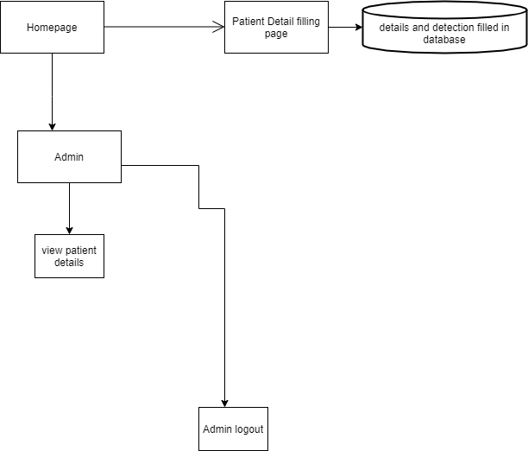
7/25
System Architecture

Slide 8
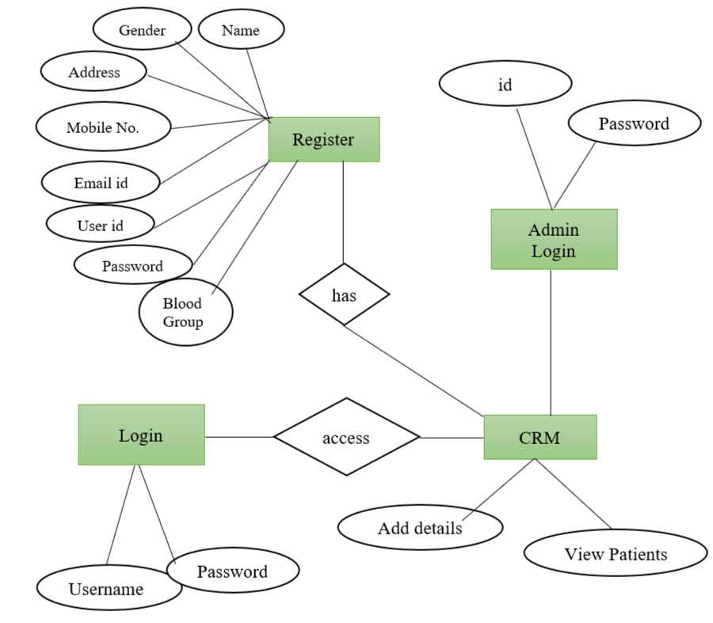
ER Diagram
8/25

Slide 9
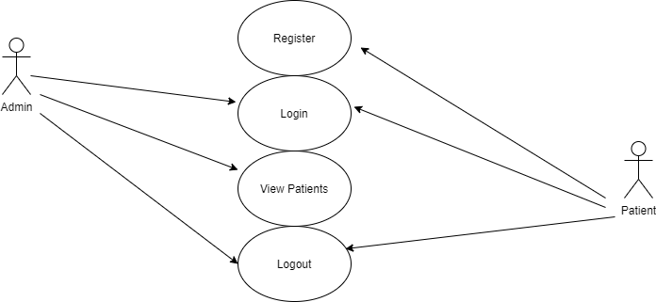
9/25
Use Case Diagram

Slide 10
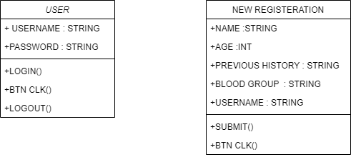
10/25
Class Diagram

Slide 11
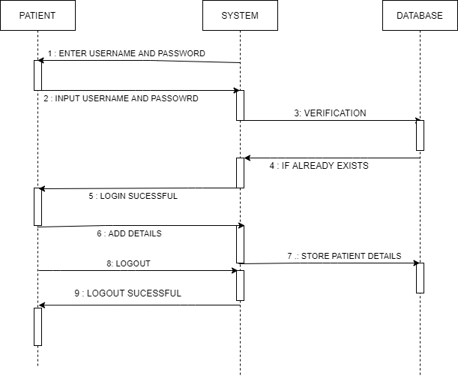
11/25
Patient Sequence Diagram

Slide 12
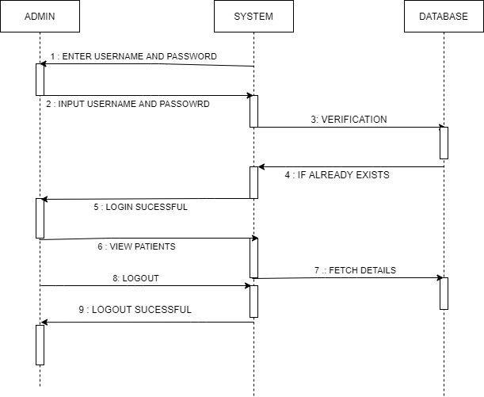
12/25
Admin Sequence Diagram

Slide 13
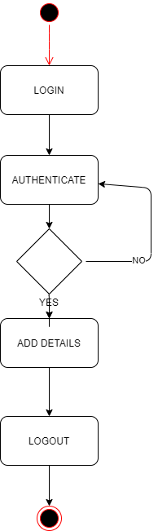
13/25
Patient Activity Diagram

Slide 14
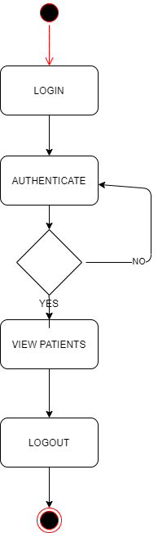
Admin Activity Diagram
14/25

Slide 15
Level 1 DFD
15/25
Process
Request
Query
1.0
User
Check for user
Requirement
User need
1.1
Feedback For
User
Relevant
Data
Database

Slide 16
Level 2 DFD
16/25
Query
2.0
Accept
Query
User
Give info about DB
2.1
Give request to user
Check Availability of or for query processing
2.2
Process
Query
Via Knee Osteoarthritis Detection DB

Slide 17
Modules
17/25
The system comprises of 2 major modules with their sub-modules as follows:
Admin:
Login-Admin can login into the system using username and password.
View Patient -Admin can view patient details.
Logout – Admin can logout from the system.
Patient:
Login – Patient can login into system using username and password.
Register-Patient can register itself in the system to predict the disease.

Slide 18
Testing
18/25
Unit Testing: This testing, was done during the programming stage itself. According to this testing, each module has been found to function satisfactorily as far as the expected output from the module is concerned.
Validation Testing: A validation test has been conducted on the proposed system under consideration, and it has been found to be working satisfactorily.
Output Testing: The outputs generated by the system for which the evaluation is being conducted are tested by asking the users about the format that they require. The output format of this document is considered from two points of view, namely on the screen as well as on paper. We have found that the format of the output on the screen is correct since the format was designed in the system design phase in accordance with the requirements of the users
User Acceptance Testing: As part of the development process of the system under study, it has been ensured that the proposed system is tested for user acceptance by keeping in continuous touch with the prospective users at the time of its development and making changes where necessary as a result

Slide 19
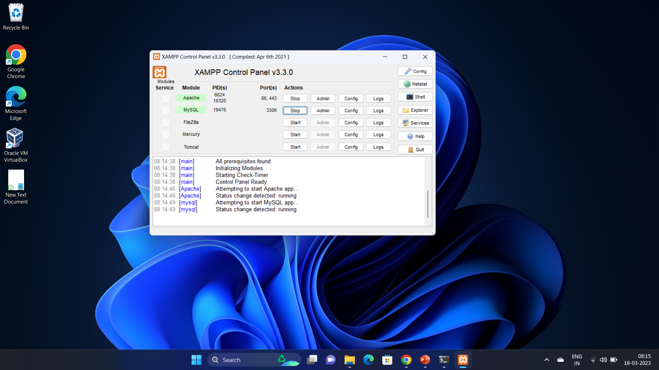
Screenshots
19/25

Slide 20
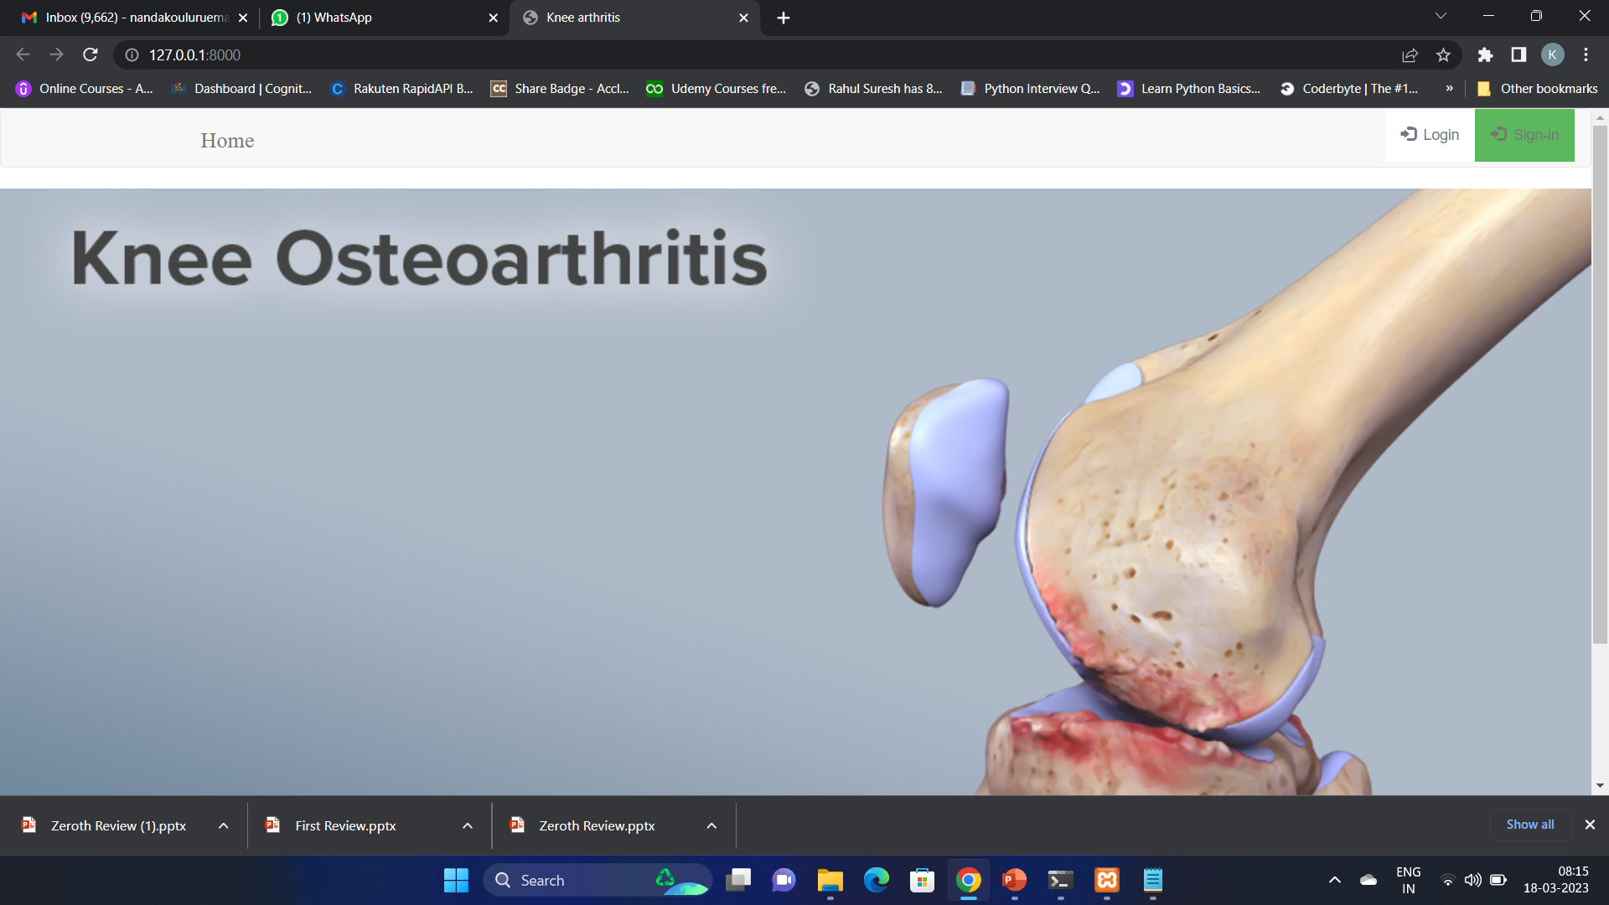
Screenshots
20/25

Slide 21
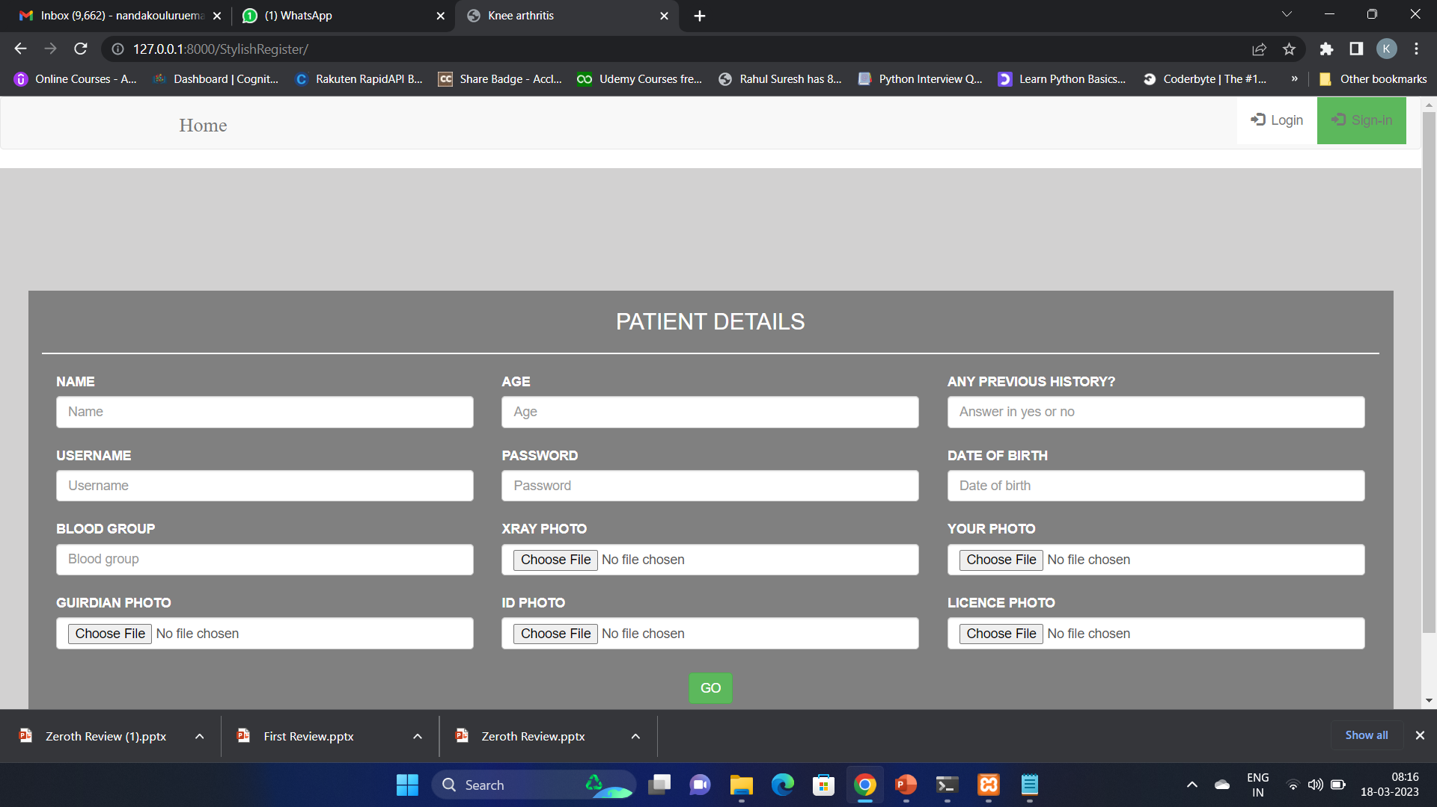
Screenshots
21/25

Slide 22
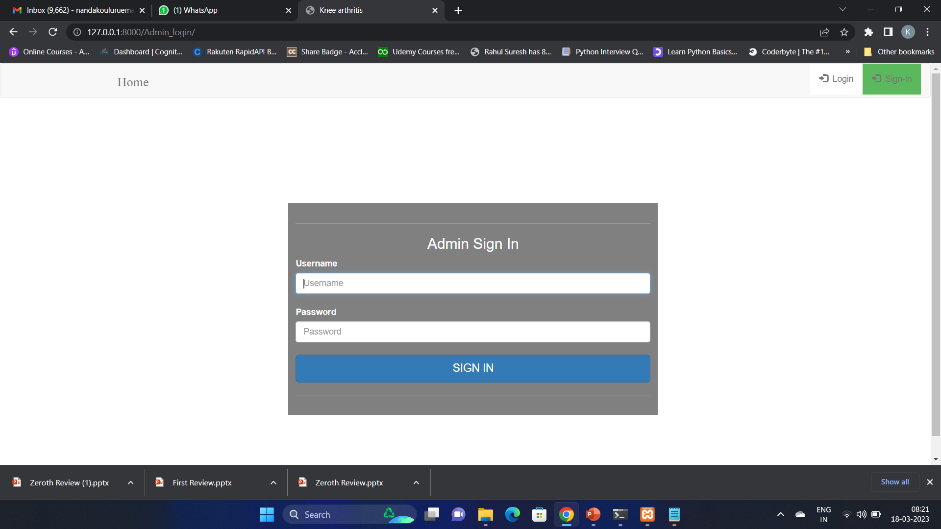
Screenshots
22/25

Slide 23
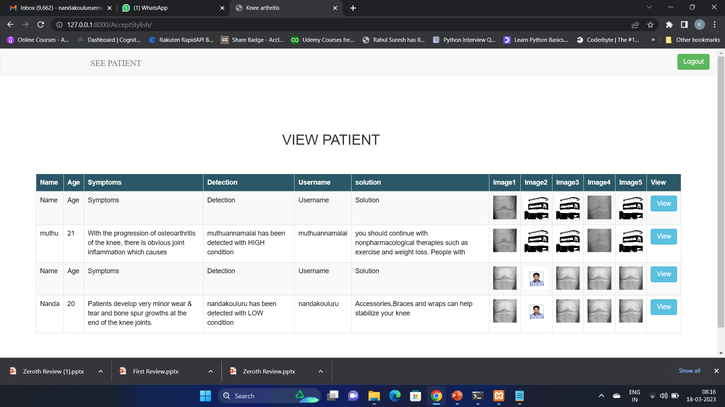
Screenshots
23/25

Slide 24
Conclusion
24/25
Developing a system that detects knee osteoarthritis and its severity in Python programming language as part of a project called System Design on Knee Osteoarthritis Detection and Severity. There is a lot of effort that goes into the development of this system on our part. As a team, we think this system has given us all a lot of satisfaction. Despite the fact that every task in this field is never said to be perfect, there may still be room to improve on this application in the future. It was a great experience for us as we learned many things about the development field and gained a lot of knowledge about it. It is our hope that this will prove fruitful for us in the future.

Slide 25
References
25/25
[1] Long, Huibin, et al. “Burden of osteoarthritis in China, 1990 – 2017: findings from the Global Burden of Disease Study 2017,” The Lancet Rheumatology, vol. 2, no. 3, pp. e164-e172, 2020.
[2] Li, M. H., et al. “Regenerative approaches for cartilage repair in the treatment of osteoarthritis,” Osteoarthritis and cartilage, vol. 25, no. 10, pp. 1577-1587, 2017.
[3]Kellgren, Jonas H., and JS1006995 Lawrence. “Radiological assessment of osteo-arthrosis,” Annals of the rheumatic diseases, vol. 16, no. 4, pp. 494, 1957.
[4]Li, Zhenliang, et al. “Deep Multi-Instance Learning with Induced Self- Attention for Medical Image Classification,” 2020 IEEE International Conference on Bioinformatics and Biomedicine (BIBM), IEEE, 2020
[5]Su, Ying, Dan Li, and Xiaodong Chen. “Lung nodule detection based on faster R-CNN framework,” Computer Methods and Programs in Biomedicine, vol. 200, pp. 105866

